Slide 1
Instructions for configuration software of upper computer for Dahua addressable fire alarm system

Slide 2
Content
1
Configuration Tool Operation Guide
2
Parameter Settings
3
Linkage Formula

Slide 3
Steps
Open Configure software (ControlConfig.exe)
Create ”New Project”
Create “New Controller”
System configuration
Add loop and import field device information
Add manual module panel and import information
Add device linkage panel and import information
Edit linkage formula
Export configuration file(.cfg) and insert to FACP

Slide 4
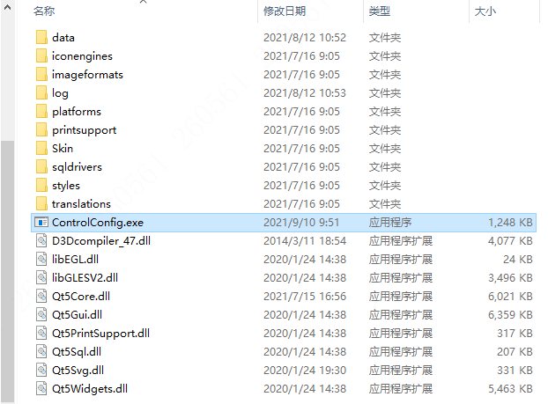
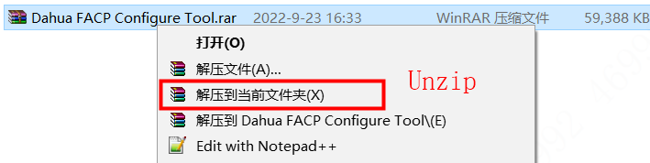
Decompress and open the configuration software
1. Decompress the file Dahua FACP Configure Tool.rar
2. Double-click the ControlConfig.exe。

Slide 5
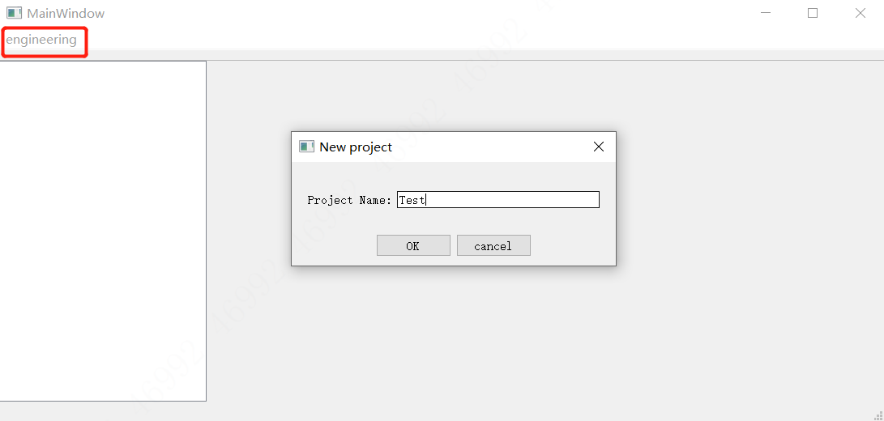
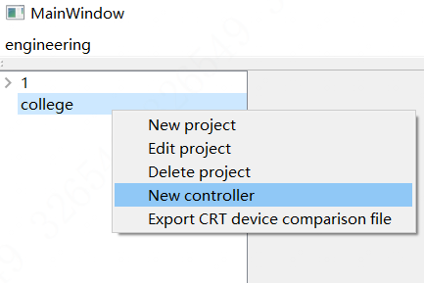
New project
3. Click 【Engineering】 to build a project, and type in the project’s name , click “OK”
4. Right-click project , Select 【New Controller】

Slide 6
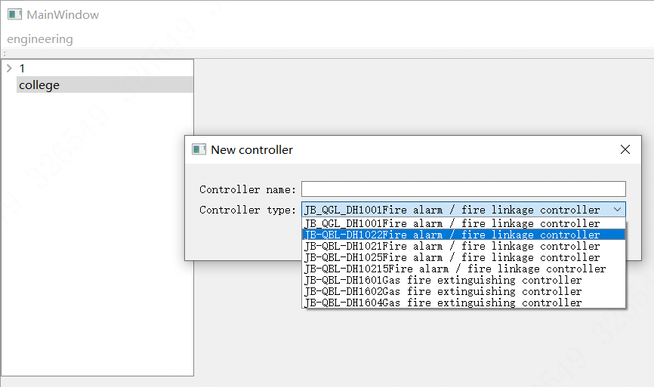
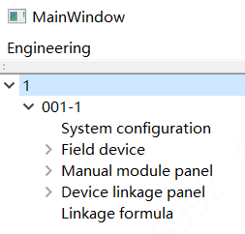
New Controller
5. Select the model of controller and name the controller, click the second one “DH1022”
6. Double-click the project and controller generated before, fill in the information of System configuration, Field device, Manual module panel, Device linkage panel, Linkage formula one by one

Slide 7
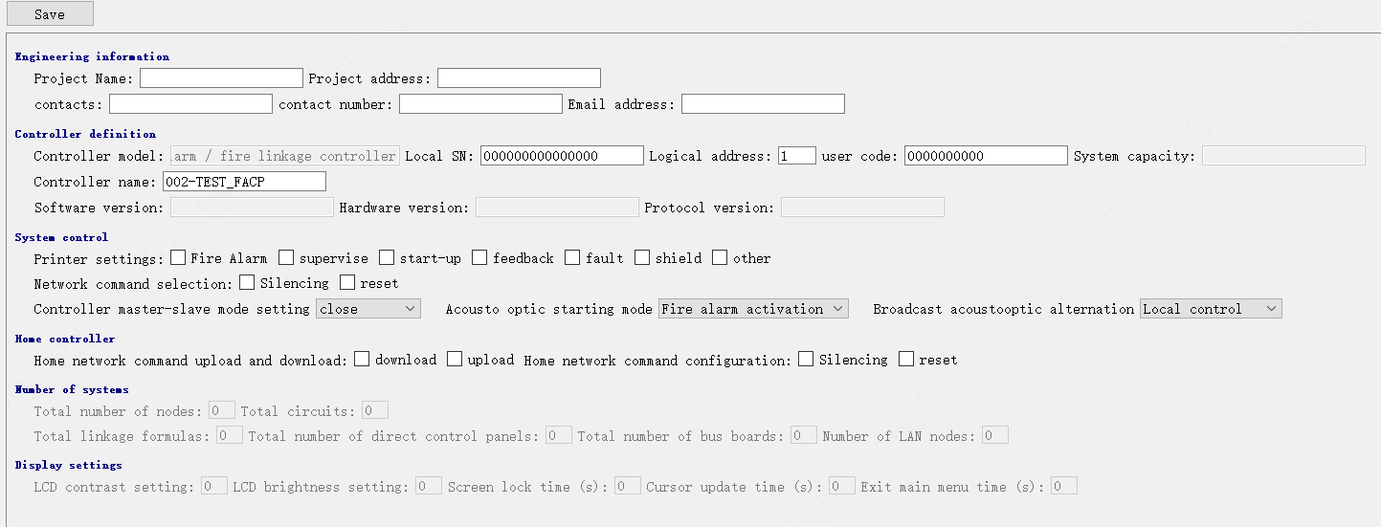
System configuration
7. Fill in the system configuration information of the controller
【Local SN】
Unique identification code of the controller
【Logical address】
The controller number cannot be duplicate when several controller used in the same project
【user code】
Controller’s Quadratic code, the last two number must be 00.
【Printer settings】
Click the corresponding print item.
When the corresponding event is reported, the printer will print the corresponding event information.
The 【local SN】 and 【Logical address】 must be consistent with the controller information, otherwise the controller cannot recognize the configuration file information.

Slide 8
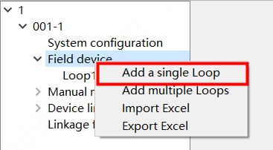
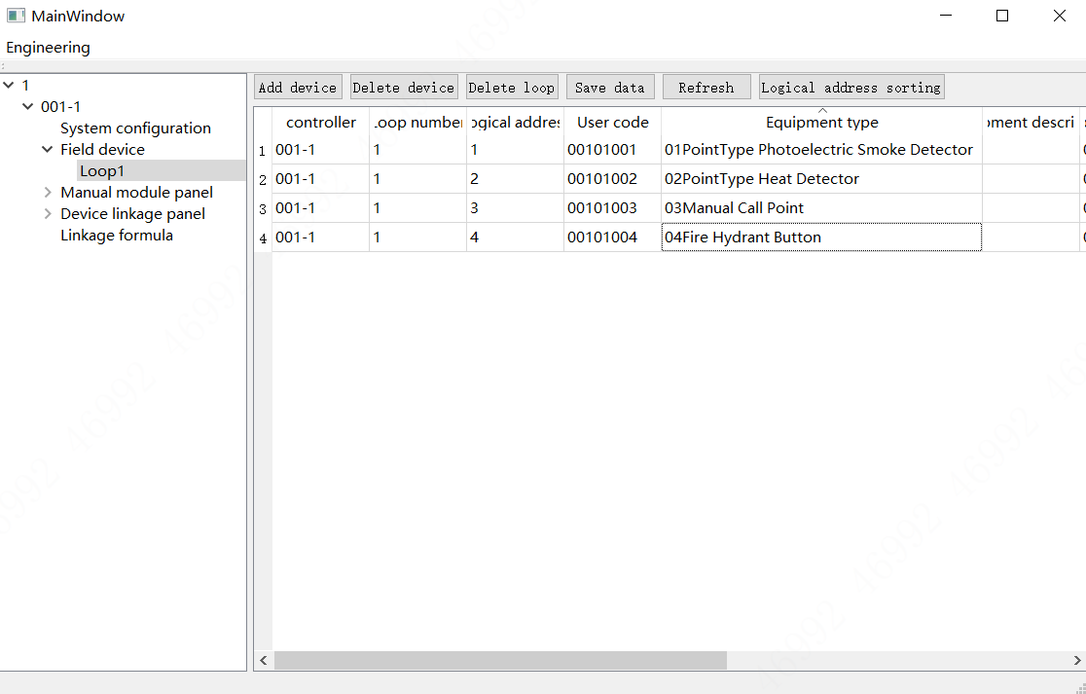


Field device information
8. Right-click the 【Field equipment】, select 【Add single loop】 or 【Add multiple loops】, DHI-HY-1022 can only add one loop.
9. Add device: add and edit the device information in the divided circuit/loop.
You can also edit the information in Excel and than import it in the software by click 【Import Excel】
The function of 【Export Excel】 can only be exported after adding devices

Slide 9
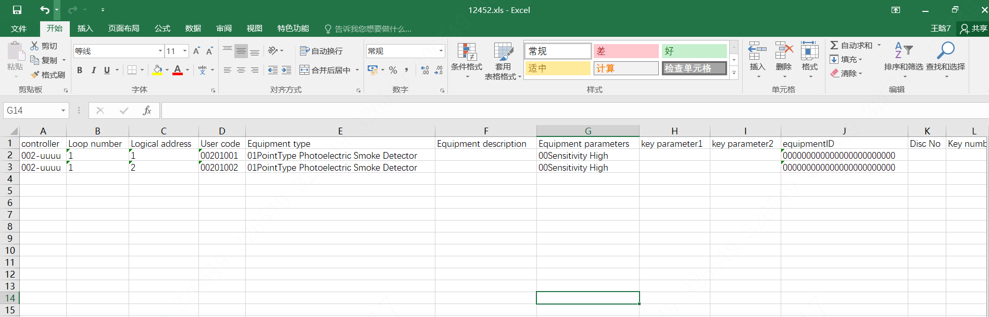

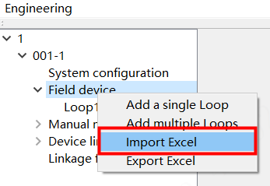
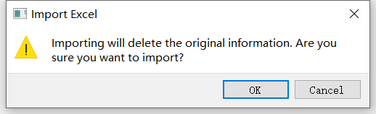
Field device information
10. Fill in all information in the Templates of Excel
“Logical address” CANNOT be repeated in the same circuit. The “User code” of device in the same project CANNOT be repeated, or an error prompt will be reported.
11. Import the edited Excel which has the information of field equipment/devices
【Import Excel】 will delete the existed information!
If the existed information needs to be used later, export the device information for backup before importing.

Slide 10
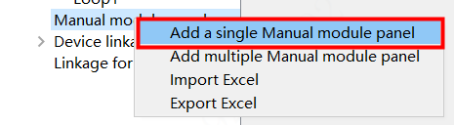
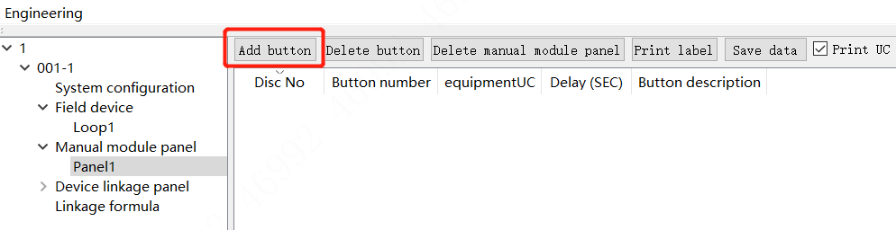
Manual module panel information
12. Right click 【Manual module panel】, select 【Add a single Manual module panel】 or 【Add multiple Manual module panel】, DHI-HY-1022 can only add one manual module panel;
13. Add Button: Type in the 【Disc No】, 【Button number】 and 【equipmentUC】, edit the description information of the button, and save the data after all buttons are edited.
When there are many buttons on manual module panel needed to be defined in the project, they can be edited and saved based on the Excel template and imported directly.
The function of 【Export Excel】 can only be exported after adding manual module panel.

Slide 11
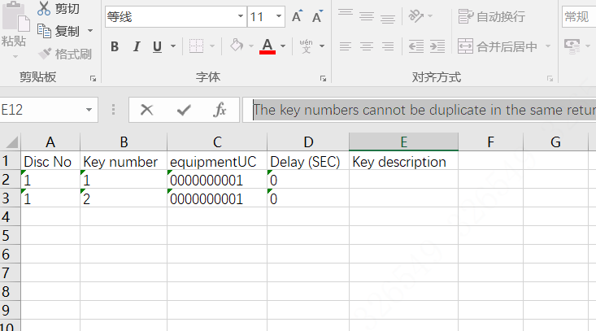
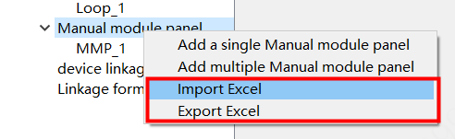
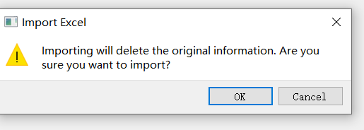
Manual module panel information
14. Fill in all information in the Templates of Excel
The “key number” CANNOT be duplicate in the same Disc number.
11、 Import the edited Excel which has the information of Manual module panel
【Import Excel】 will delete the existed information!
If the existed information needs to be used later, export the device information for backup before importing.

Slide 12
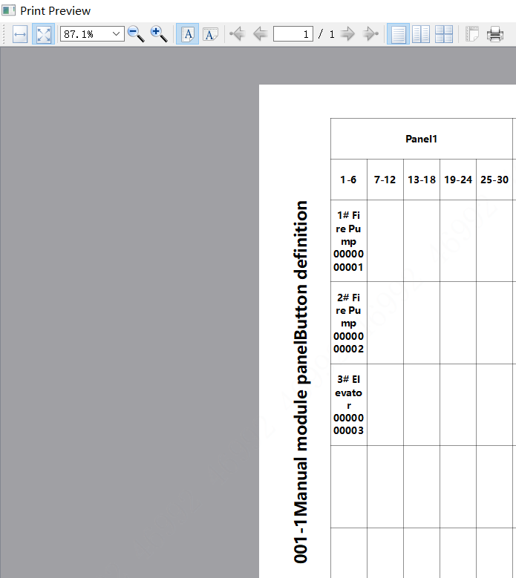
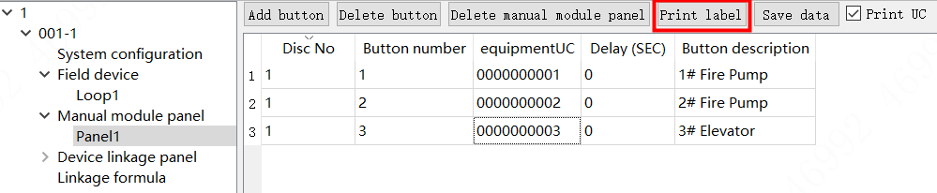
Export and print Manual Module Panel labels
16. Click 【Print label】 in the menu, the configuration software will generate PDF labels according to the existing configuration, and select "Actual Size" when printing.
*The editing of the device linkage panel is similar to that of the manual module panel

Slide 13
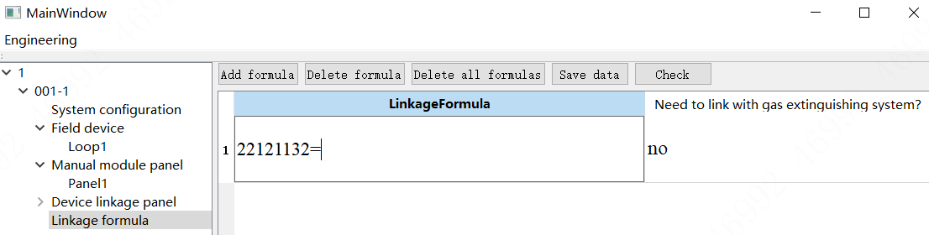
Linkage Formula Editing
17. Double-click 【Linkage formula】 , support single addition and Excel import.
Create linkage formula ：
When there are many linkage formulas needed to be created in the project, can use 【Import Excel】
Please add 0100 to the last four digits of formula input user code(UC) ;
Please add 0100 to the last four digits of formula output user code(UC);
The added 0100 will be automatically matched to the specific action type after importing Fire;
The added four number, the first two number”01”means active, “00” means stop; The last two number”00”means delay 0s, “10”means delay 16s in hexadecimal
The function of 【Export Excel】 can only be exported after adding linkage formula

Slide 14
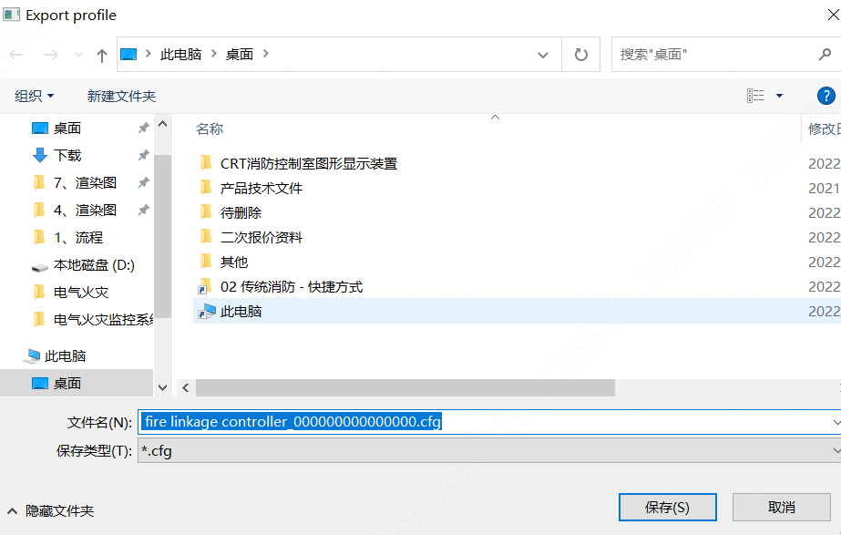
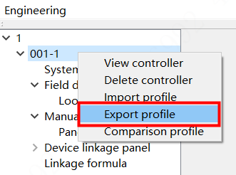
Export Profile
18. After the system configuration, field equipment, bus panel, direct control panel and linkage formula information are all prepared and confirmed, select the controller in the project and right click to export the configuration file
Please rename the .cfg file with only 7 characters before importing it to the Fire Alarm Control Panel.
19. Copy the exported .cfg file to the USB flash drive

Slide 15
Profile import to controller
20. Connect the USB flash disk to the USB port on the circuit board of the controller.
21. Perform the following operations after switching controller to debugging mode:
Main Menu - 6. System Debugging - 6. Configuration Synchronization - 2. USB Disk Import Configuration information.
This completes the creation of project information and the import of controller configuration file.
Then, test and configure your fire alarm system according to the fault information on-site.

Slide 16
Content
1、controconfig操作步骤
1
Configuration Tool Operation Guide
1
1
2
Parameter Settings
Linkage Formula
3
3、联动公式
3

Slide 17
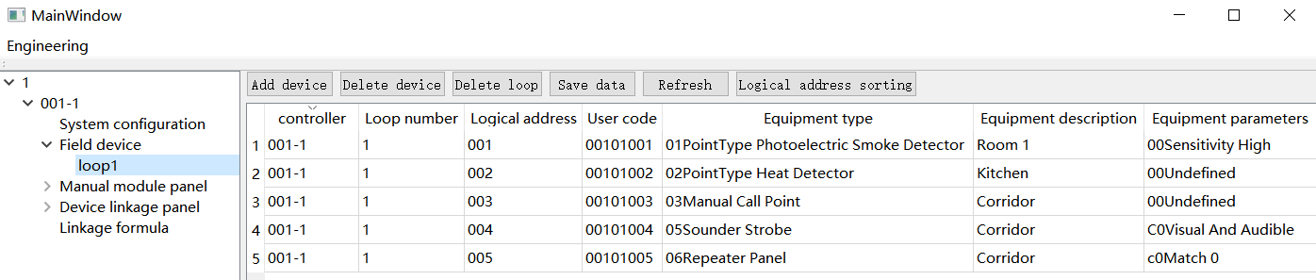
Parameter Settings
Parameter | Description
Controller | When there are multiple controllers in the project, it is necessary to distinguish the names of the controllers.
Loop number | Edit according to the number of project loops, DH1022 has only ONE loop.
Logical address | Encode unique logical addresses for devices in each loop. Range is 1~254.
User code | The secondary code for user equipment linkage programming, consisting of 10-digit codes. The first 8 digits can be set arbitrarily under the device definition menu (requiring that the digital code of the device in the same project is unique), and the user can also give each code a specific meaning.
Equipment description | The information description of the specific location or specific function of the equipment is convenient for query and later maintenance.
Equipment parameters | Status parameters of the device's function

Slide 18
Device Type
Device Type List
00 | Fire Alarm Control Panel |  | 40 | Fire Sprinkler Pump |  | 82 | Diesel Generator
01 | Point Type Photoelectric Smoke Detector |  | 41 | Water Flow Indicator |  | 83 | Lighting Power Distribution Cutting
02 | Point Type Heat Detector |  | 42 | Butterfly Valve |  | 84 | Power Distribution Cutting
03 | Manual Call Point |  | 44 | Pressure Switch |  | 86 | Exhaust Fan
04 | Fire Hydrant Button |  | 45 | Fire Stabilizer Pump |  | 87 | Air Blower
05 | Sounder Strobe |  | 46 | Fire Pump |  | 88 | Air Blower
06 | Repeater Panel |  | 47 | Fire Water Storage Tank |  | 89 | Remote Control Valve
07 | Input Module |  | 48 | Flow Switch |  | 8a | Smoke Exhaust Window
08 | Output Module |  | 50 | Fire Selector Valve |  | 90 | Smoke Damper
09 | Input Module |  | 51 | Smoke Exhaust Fan |  | 91 | Fire Rolling Shutter Half Fall
0a | Isolator Module |  | 55 | Air Blower |  | 98 | Access Control
30 | Gas Extinguishing Control Panel |  | 56 | Electronically Controlled Smoke Barrier |  | 99 | Air Compressor
31 | Gas Release Warning Signage |  | 57 | Fire Rolling Shutter |  | 9a | Transfer Pump
32 | Emergency Active Stop Button |  | 58 | Elevator |  | 9d | 70 Degree Normally Open Smoke Exhaust Fire Damper
33 | Gas Extinguishing Zone |  | 59 | Positive Pressure Ventilation Fan |  | 9e | 70 Degree Normally Closed Smoke Exhaust Fire Damper
3d | Speaker Monitoring Module |  | 81 | Air Conditioning Unit |  | 9f | 280 Degree Normally Open Smoke Exhaust Fire Damper

Slide 19
User Code Definition
Digit | 1st | 2nd | 3rd | 4th | 5th | 6th | 7th | 8th | 9th | 10th
User Code | X | X | X | X | X | X | X | X | X | X
Note | Building Number |  | Unit Number | Floor Number |  | Logical Address |  |  | Device Type
The first 8 digits can actually be edited at will, but the 8-digit number CANNOT be repeated in the same project.
It is recommended to edit according to the following logic:
1st and 2nd digits represent the building number
3rd digit represents the unit number,
4th and 5th digits represent the floor number (-1, -2 and -3 floors are represented by 91, 92, and 93 respectively)
6th, 7th and 8th digits represent logical addresses
9th and 10th digits must be the device type
e.g.1. User code of No.4 Smoke Detector (device type is 01) on 3rd Floor, Unit 2, Building No.1 can be defined as 0120300401；
e.g.2. User code of No.7 Sounder Strobe (device type is 05) on 2nd Floor, Unit 1, Building No.2 can be defined as 0210200705；
For underground garage：
1st digit is 9
2nd and 3rd digits represent zone number
4th and 5th digits represent the floor number (-1, -2 and -3 floors are represented by 91, 92, and 93 respectively)
6th , 7th and 8th digits represent logical addresses
9th and 10th digits must be the device type
e.g.1. User code of No.4 Smoke Detector (device type is 01) on -2 Floor, Zone 3 of underground garage can be defined as 9039200401 ；

Slide 20
Content
1
Configuration Tool Operation Guide
1
1、controconfig操作步骤
1
Parameter Settings
2
2、设备参数
2
3
Linkage Formula

Slide 21
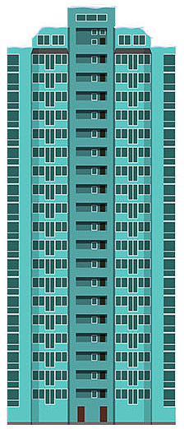
Linkage Formula
The linkage formula consists of input part and output part, which are connected by "=". Each input part and each output part are composed of user code and four-digit suffix. When editing the linkage formula on the controller, the four-digit suffix of the input part will match the device type and pop up automatically. The first two digits of the four-digit suffix of the output part are 01, and the last two digits are the delay time (hexadecimal). After editing, press the “Save" button and the system will automatically save.
Usage of symbol “=“ , “×” and “+”
In front of "=" is the input part.
When there are multiple input parts, each input part is connected by a relational operator "×" or "+". The logical symbol "×" stands for "and", symbol "+" stands for "or". "+" can only appear in input items.
"=" is followed by the output part.
When there are multiple output items, each output item is connected by a relational operator "×" (the output part cannot be connected by a "+" sign).
the linkage formula uses the equal sign "=" to represent the causal relationship.
When the conditions of the input items are met and the controller is in the automatic state, the output items can be automatically linked to start.
There can only be ONE equal sign "=" in a linkage formula.

Slide 22
Linkage Formula
Example 1
Initiating products:
No.1 smoke detector on the 3rd floor, Unit 2, Building No.1
AND
No.2 manual call point on the 3rd floor, Unit 2, Building No.1
Want to link:
No.4 sounder strobe on the 3rd floor, Unit 2, Building No.1
No.5 input and output module on the 3rd floor, Unit 2, Building No.1
with a delay of 6 seconds
The linkage formula is:
01203 001 01 0100 × 01203 002 03 0100 = 01203 004 05 0100 × 01203 005 09 0106
Example 2
Initiating products:
No.1 smoke detector on the 3rd floor, Unit 2, Building No.1
OR
No.2 manual call point on the 3rd floor, Unit 2, Building No.1
Want to link:
No.4 sounder strobe on the 3rd floor, Unit 2, Building No.1
No.5 input and output module on the 3rd floor, Unit 2, Building No.1
with a delay of 6 seconds
The linkage formula is:
01203 001 01 0100 + 01203 002 03 0100 = 01203 004 05 0100 × 01203 005 09 0106

Slide 23
Linkage Formula
Usage of symbol “*”
In the linkage formula, "*" can be used to represent any meaning, and it can be used to represent any number between 0 and 9.
Example
Initiating products:
Any smoke detector on the 3rd floor, Unit 2, Building No.1
AND
Any manual call point on the 3rd floor, Unit 2, Building No.1
Want to link:
all sounder strobes on the 3rd floor, Unit 2, Building No.1
all input and output modules on the 3rd floor, Unit 2, Building No.1
with a delay of 6 seconds
The linkage formula is:
01203 *** 01 0100 × 01203 *** 03 0100 = 01203 *** 05 0100 × 01203 *** 09 0106
9th and 10th digits must be the device type, they cannot be replaced by “*”

Slide 24
Linkage Formula
Usage of symbol “#”
Symbol "#" can be used in the linkage formula to indicate that location information in the user code(UC) is are same, but "#" must appear at the same position in all input item user codes or output item user codes.
Example
Initiating products:
Any smoke detector on the 3rd floor, Unit 2, Building No.1
AND
Any manual call point on the 3rd floor, Unit 2, Building No.1
Want to link:
all sounder strobes on the 3rd floor, Unit 2, Building No.1
all input and output modules on the 3rd floor, Unit 2, Building No.1
with a delay of 6 seconds
The linkage formula is:
01### *** 01 0100 × 01###*** 03 0100 = 01### *** 05 0100 × 01### *** 09 0106
Same location
In one user code(UC), only 5 "#“ can be used in maximum, and there should be no “spaces” in the linkage formula.

Slide 25
Linkage Formula
Usage of symbol “#”
Initiating products:
Any TWO smoke detectors on the 3rd floor, Unit 2, Building No.1
OR
Any manual call point on the 3rd floor, Unit 2, Building No.1 AND any smoke detector on the 3rd floor, Unit 2, Building No.1
Want to link:
all sounder strobes on the 3rd floor, Unit 2, Building No.1
all input and output modules on the 3rd floor, Unit 2, Building No.1
with a delay of 6 seconds
The linkage formula is:
#####***014002×#####***014002+#####***030100×#####***014002=#####***050100×#####***090106
In one user code(UC), only 5 "#“ can be used in maximum, and there should be no “spaces” in the linkage formula.

